Slide 1


INTRO. TO PROGRAMMING
LANGUAGES
AND THEIR APPLICATIONS
MOHAMED SAIED

Slide 2

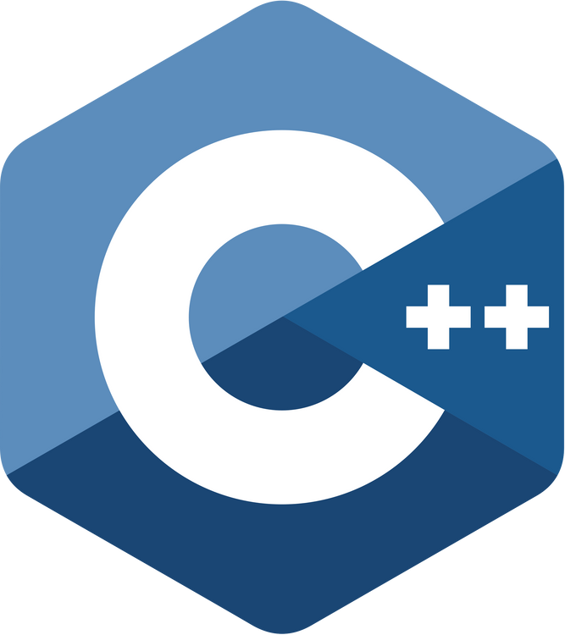



Slide 3
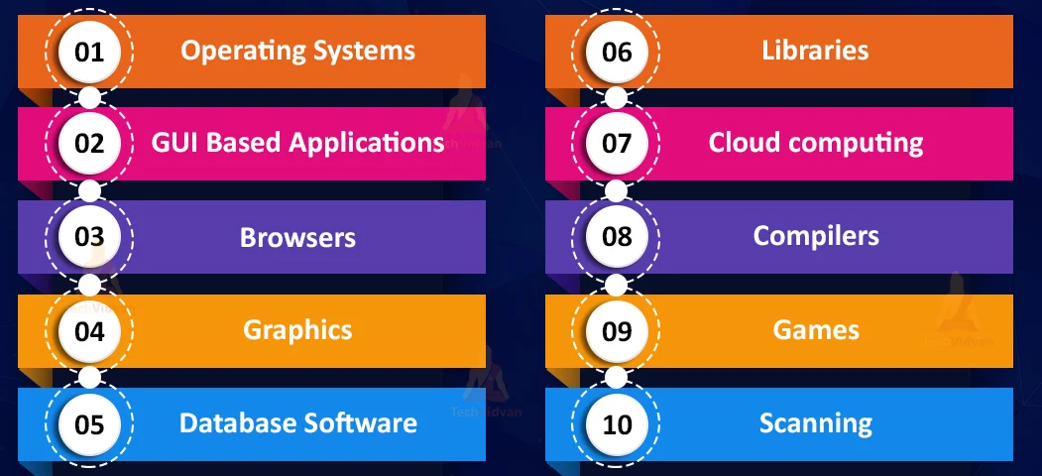
C++ APPLICATIONS

Slide 4
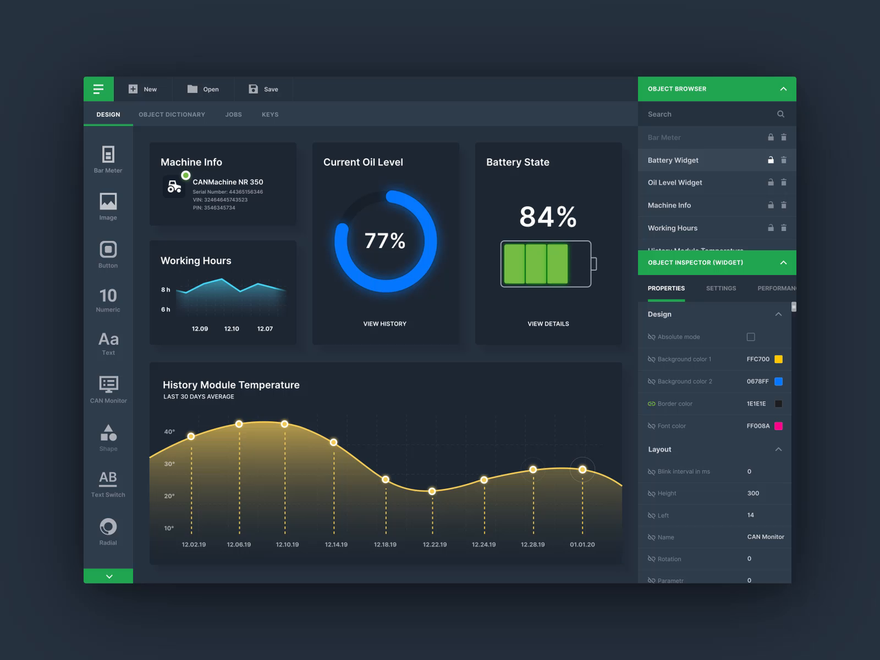
GUI AND DESKTOP APPLICATIONS

Slide 5
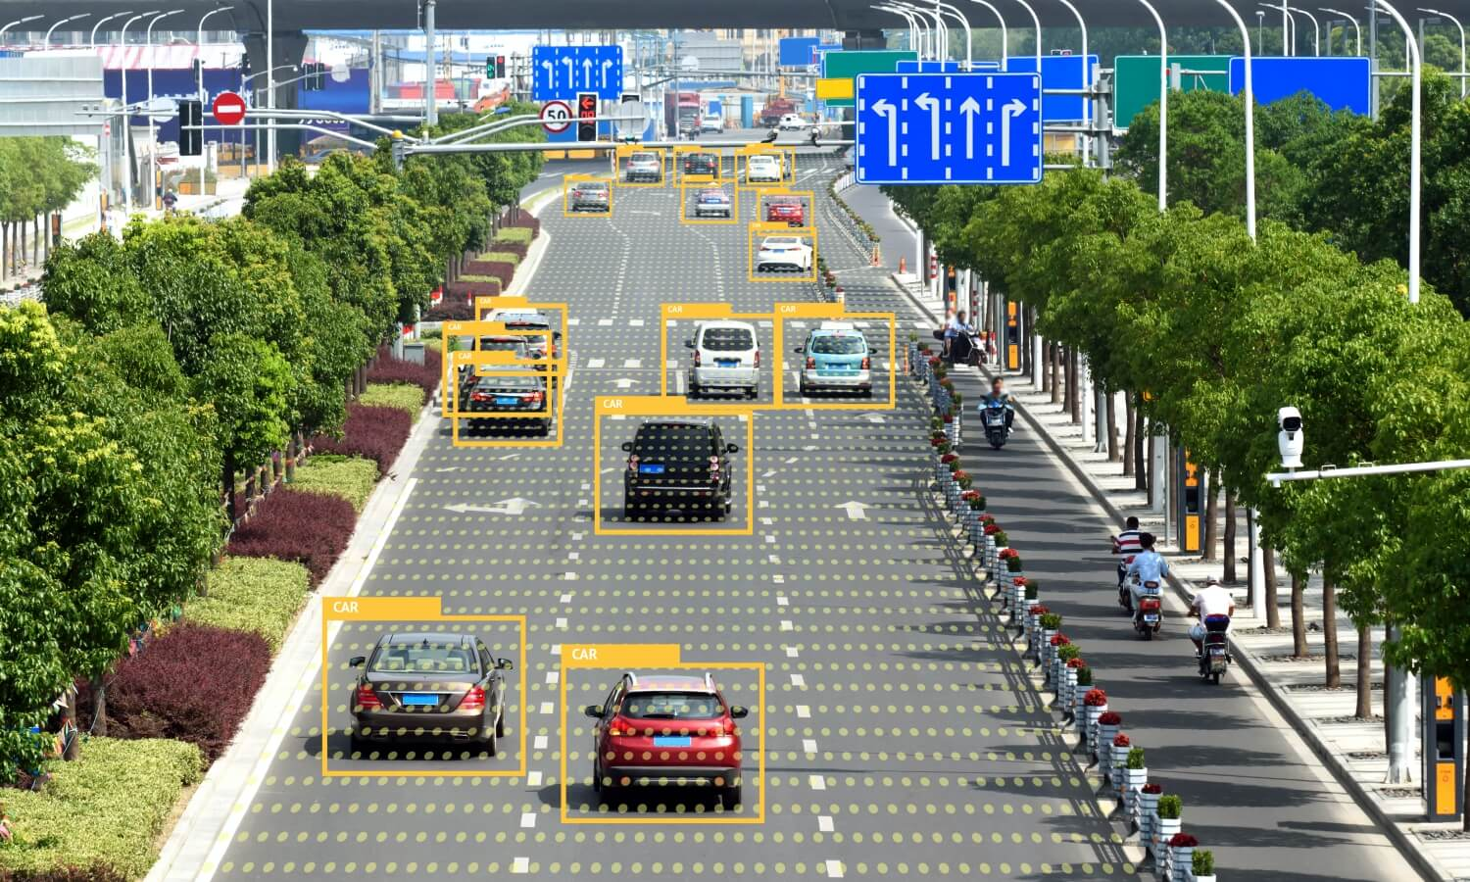
COMPUTER VISION APPLICATIONS

Slide 6
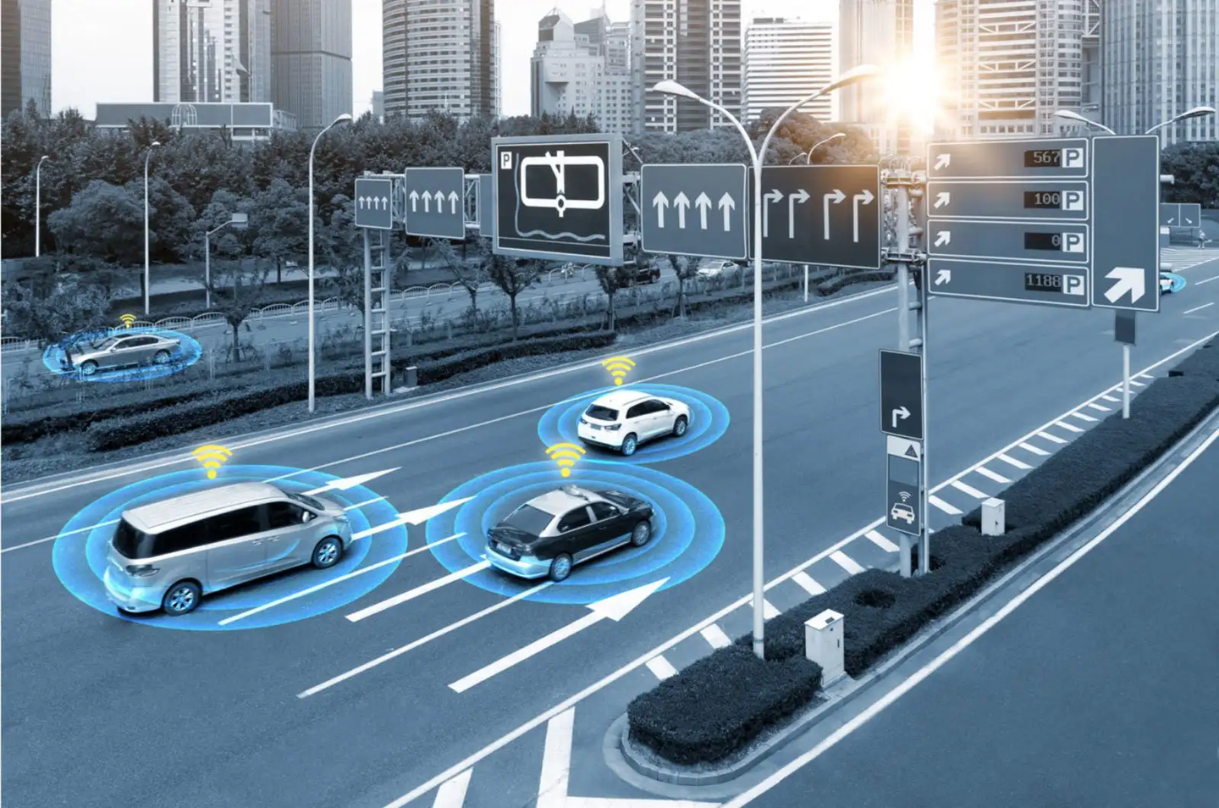
CONNECTED CARS

Slide 7
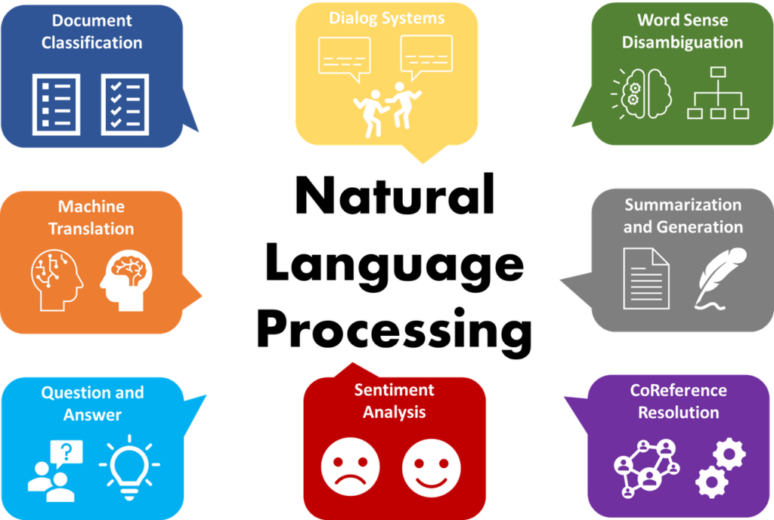
GENERAL AI APPS
such as Natual language processing Models
Generative AI
Natrual Language Processing

Slide 8
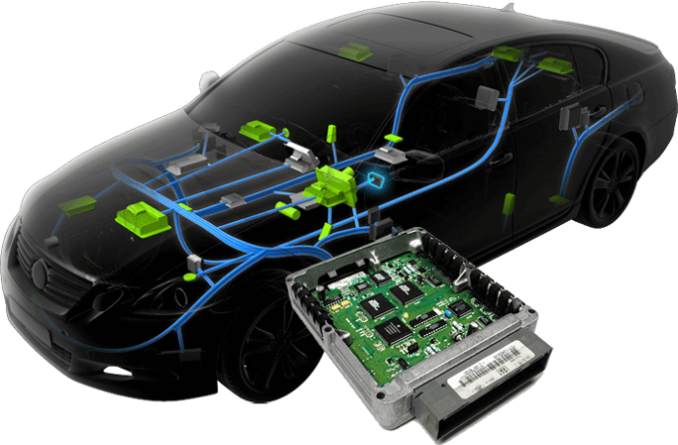
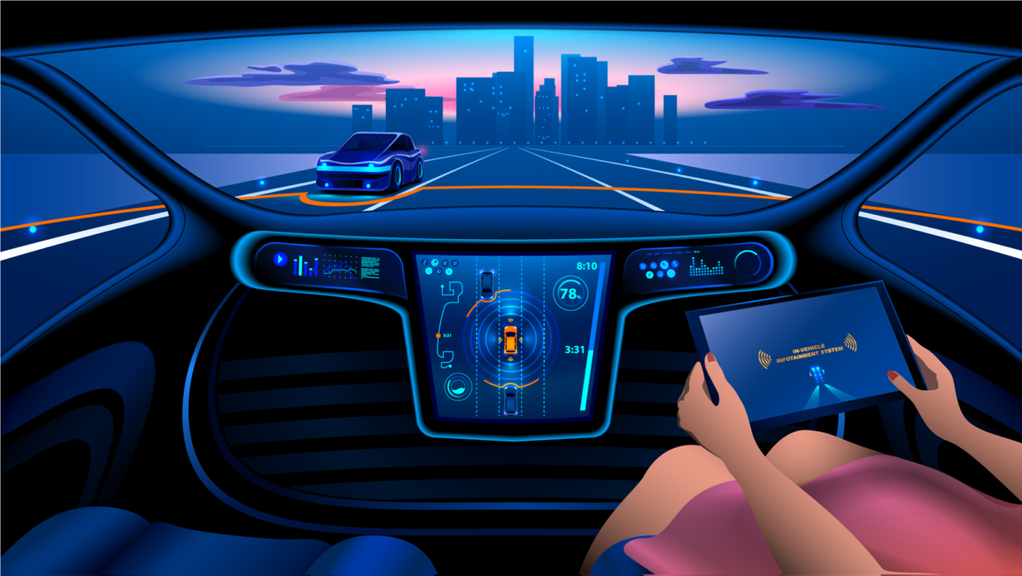
EMBEDDED SYSTEMS
Embedded Systems for Automotive
Embedded IoT
Embedded GUI Apps
Infotainment ECUs

Slide 9
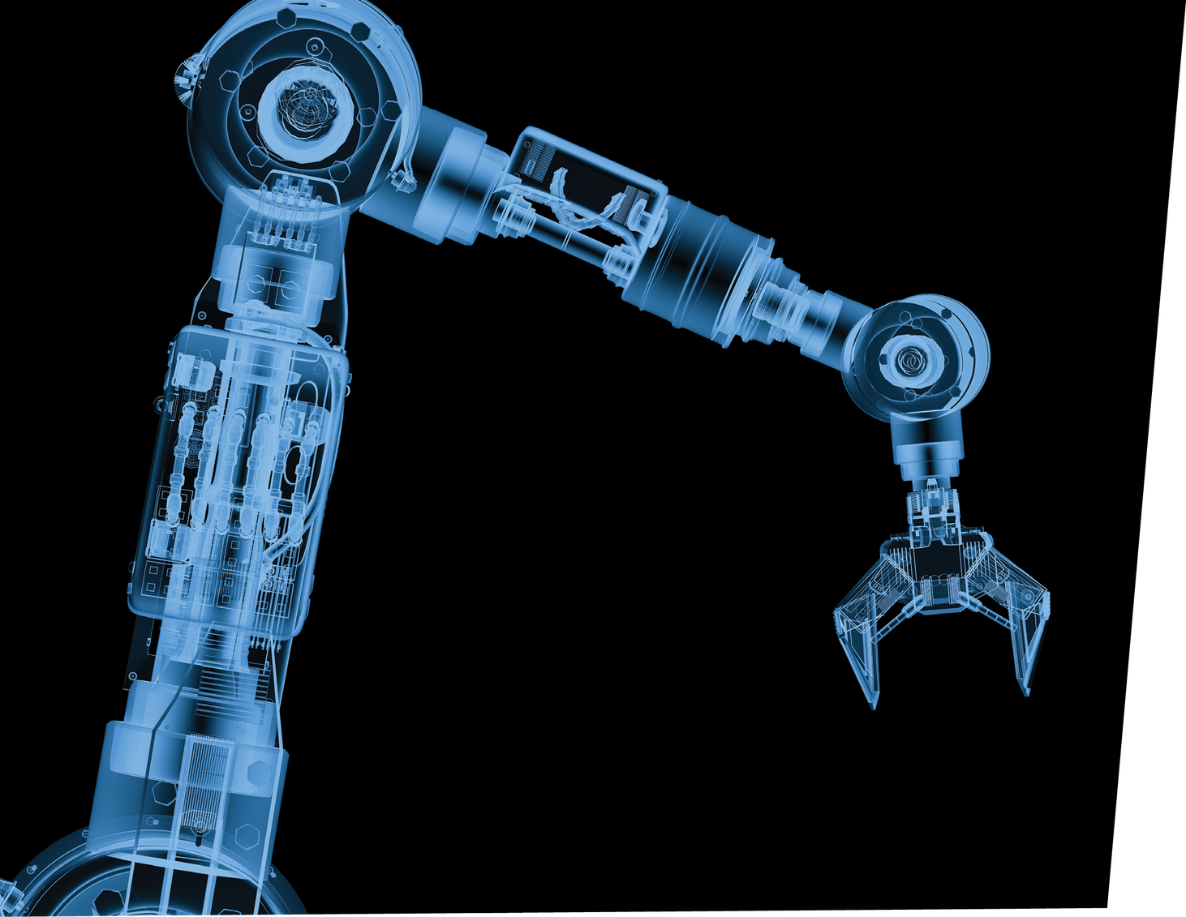
ROBOTICS
Famous frameworks which are used in many Robotics Applications such as Self-Driving Cars
ROS is an example

Slide 10
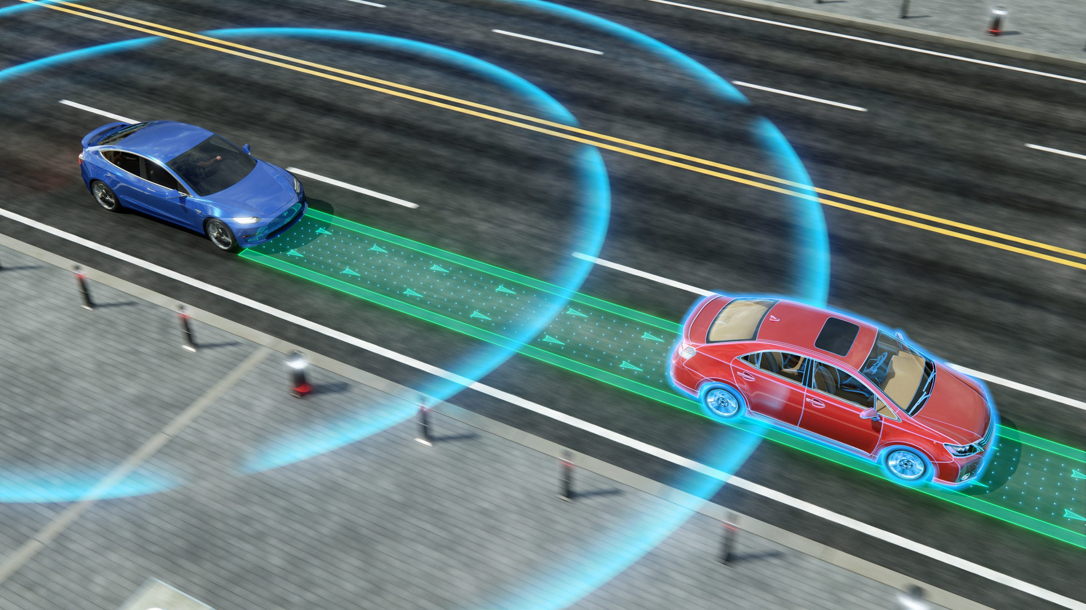
ROBOTICS : SELF-DRIVING CARS

Slide 11
INTRO TO COMPUTER ARCHITECTURE

Slide 12
COMPILER VS INTERPRETER VS TRANSPILER
Compiler - compiles code to a lower level code in one go and generates executable files.
and executables will run later.
Example:
"Developer code" -> "Machine code"
Interpreter: compiles and run each line separately
such as python and php language
Transpiler - compiles code to same level of code/abstraction.
Example:
"Developer code" -> "Another developer code or version"
JavaScript ES2015+ -> JavaScript ES5
C/C++
ASSEMBLY
MACHINE CODE
EXECUTABLE FILE

Slide 13
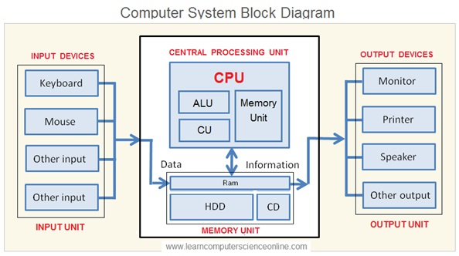

Slide 14
WHAT ARE MEMORY TYPES
TYPES OF MEMORY
DATA MEMORY
PROGRAM MEMORY

Slide 15
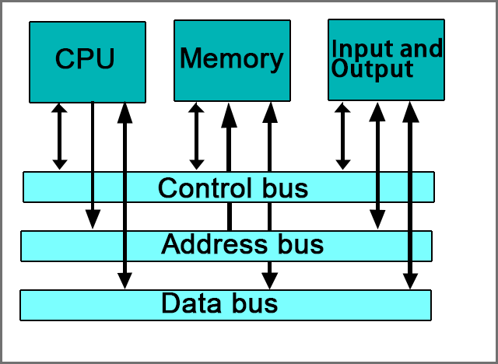
WHAT ARE BUS TYPES
8 BITS
16 BITS
32 BITS
64 BITS

Slide 16
Processing life cycle
FETCH
EXECUTE
DECODE

Slide 17
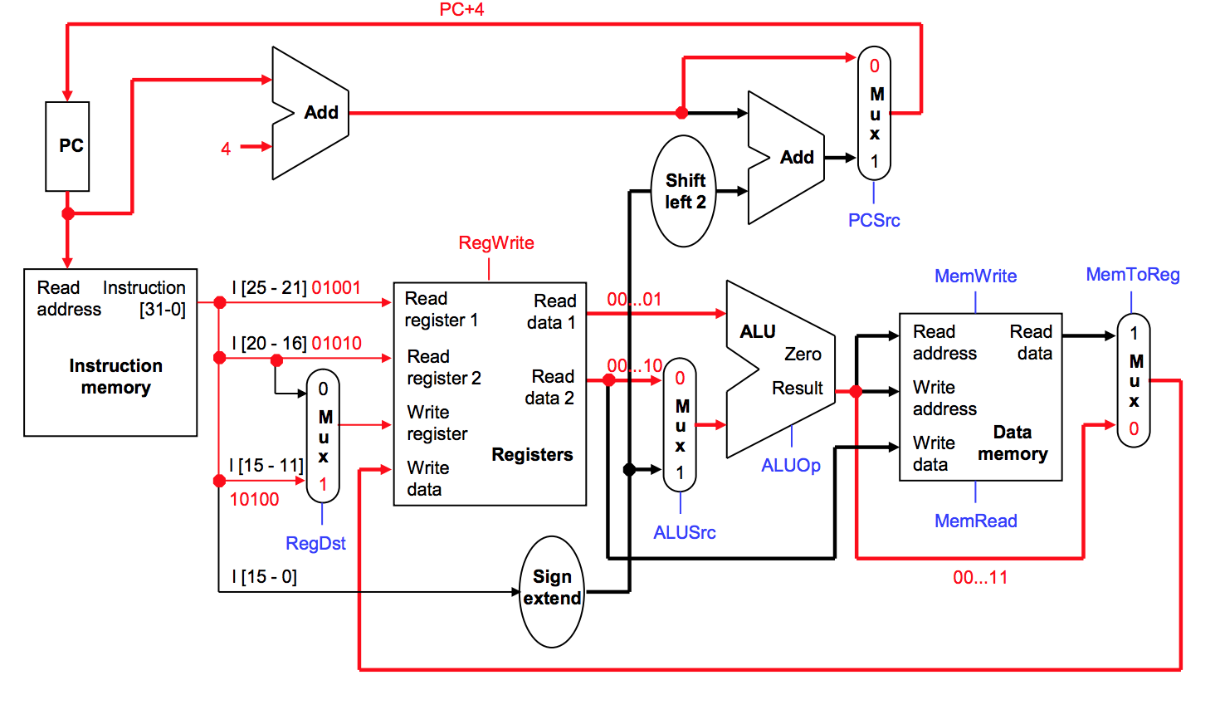
Processor Architecture

Slide 18
Thank you

